Slide 1

Topic: Fractions
EQ: What is another way of adding and subtracting fractions with different denominators?

Slide 2

24
7
30
Topic: Fractions
Date
EQ: What is another way of adding and subtracting fractions with different denominators?
Let’s get thinking!
1$\frac{1}{4}+2\frac{1}{3}$
How can we find the solution to this?
How would it look using our grid paper? (last lesson)
Discuss it with your shoulder partner & be prepared to share.

Slide 3

24
7
30
Topic: Fractions
Date
EQ: What is another way of adding and subtracting fractions with different denominators?
$$\frac{1}{4}+\frac{1}{3}$$
Step 1: Find the Lowest Common Denominator (LCD)
12
Step 2: Multiply the denominators and numerators so the fractions reflect the LCD
Finding the Lowest Common Denominator

Slide 4

24
7
30
Topic: Fractions
Date
EQ: What is another way of adding and subtracting fractions with different denominators?
Step 2: Multiply the denominators and numerators so the fractions reflect the LCD
$\frac{1}{4} + \frac{1}{3}$
$$\frac{3}{12} + \frac{4}{12}=\frac{7}{12}$$
Finding the Lowest Common Denominator

Slide 5
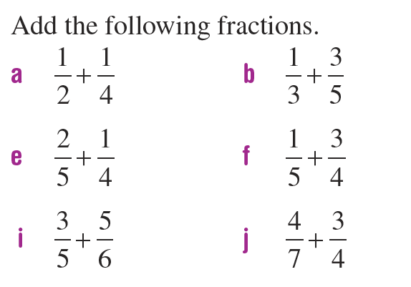
24
7
30
Topic: Fractions
Date
EQ: What is another way of adding and subtracting fractions with different denominators?
In groups/pairs on a piece of paper:

Slide 6
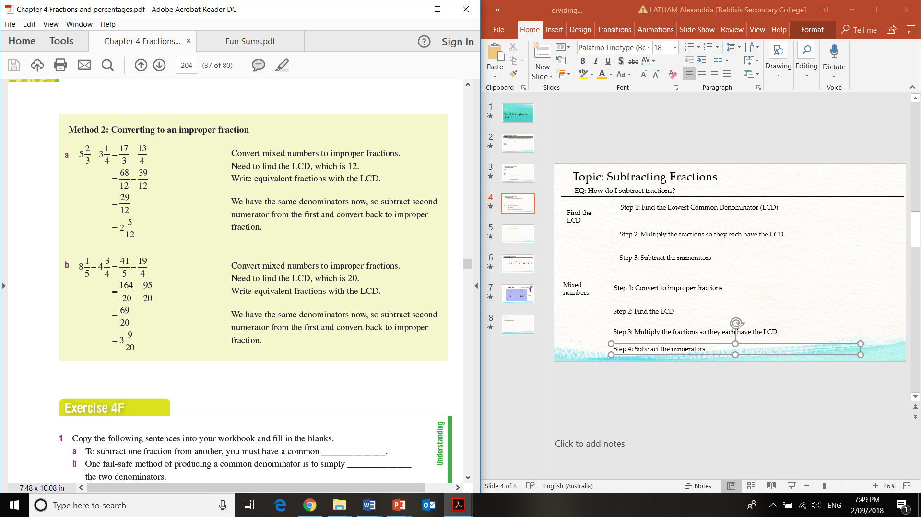
24
7
30
Topic: Fractions
Date
EQ: What is another way of adding and subtracting fractions with different denominators?
Mixed Fractions
Step 1: Convert to improper fractions
Step 2: Find the LCD
12
Step 3: Multiply the fractions so they each have the LCD
Step 4: Subtract the numerators

Slide 7
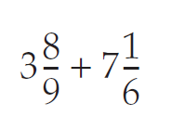
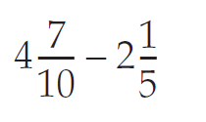
24
7
30
Topic: Fractions
Date
EQ: What is another way of adding and subtracting fractions with different denominators?
We do:

Slide 8
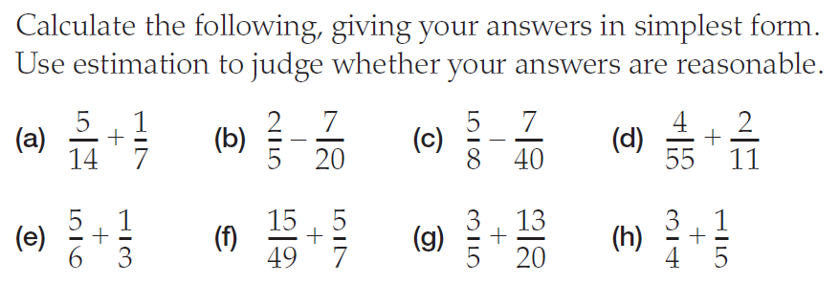
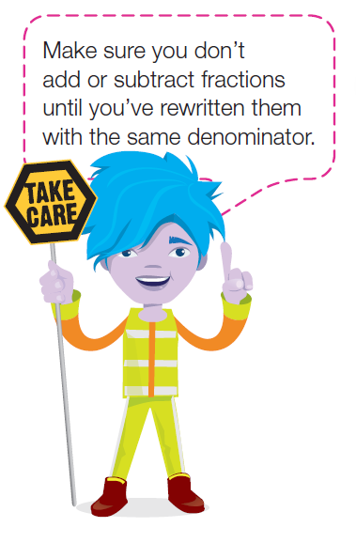
24
7
30
Topic: Fractions
Date
EQ: What is another way of adding and subtracting fractions with different denominators?
In your pairs/group on a piece of a paper:

Slide 9


Slide 10
24
7
30
Topic: Fractions
Date
EQ: How do we use arrays to add and subtract fractions?
Write your summary in your interactive notebook.
Discuss with your shoulder partner/table.
Be prepared to share ☺
.
.

